Slide 1





Computational Thinking with Programming
Fall 2019
@cse_bennett
@csebennett

Slide 2
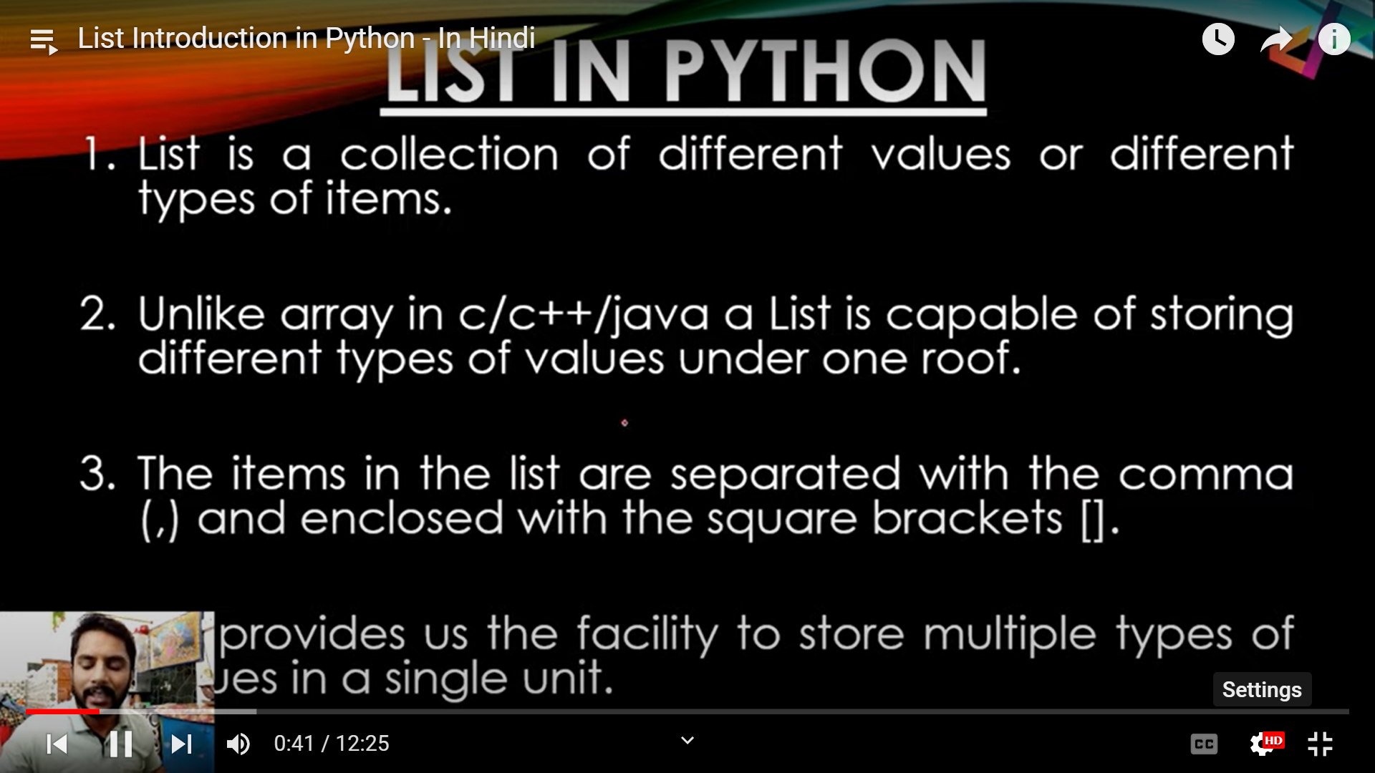

Slide 3
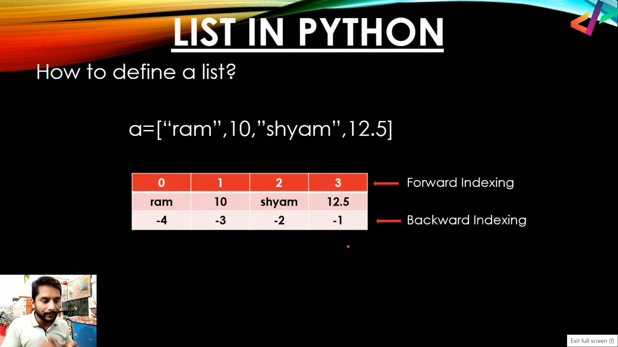

Slide 4
Python Collections/Sequences (Arrays)
List is a collection which is ordered and changeable. Allows duplicate members.
Tuple is a collection which is ordered and unchangeable. Allows duplicate members.
Set is a collection which is unordered and unindexed. No duplicate members.
Dictionary is a collection which is unordered, changeable and indexed. No duplicate members.

Slide 5
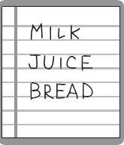
List Structures

Slide 6
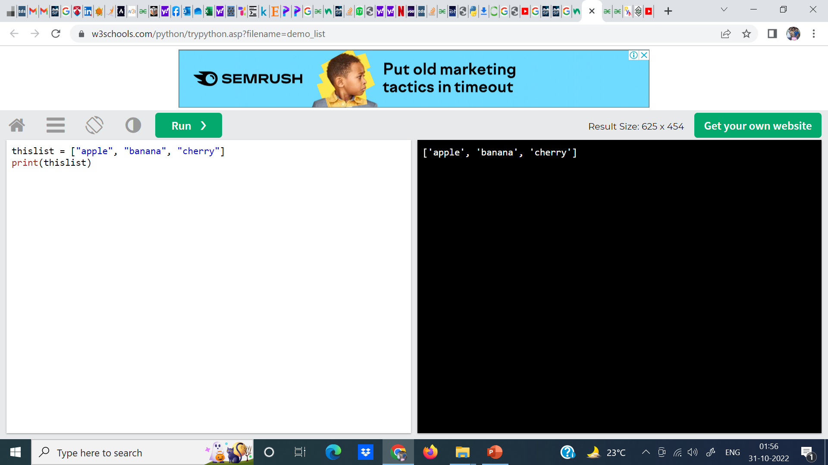
Lists are used to store multiple items in a single variable.

Slide 7
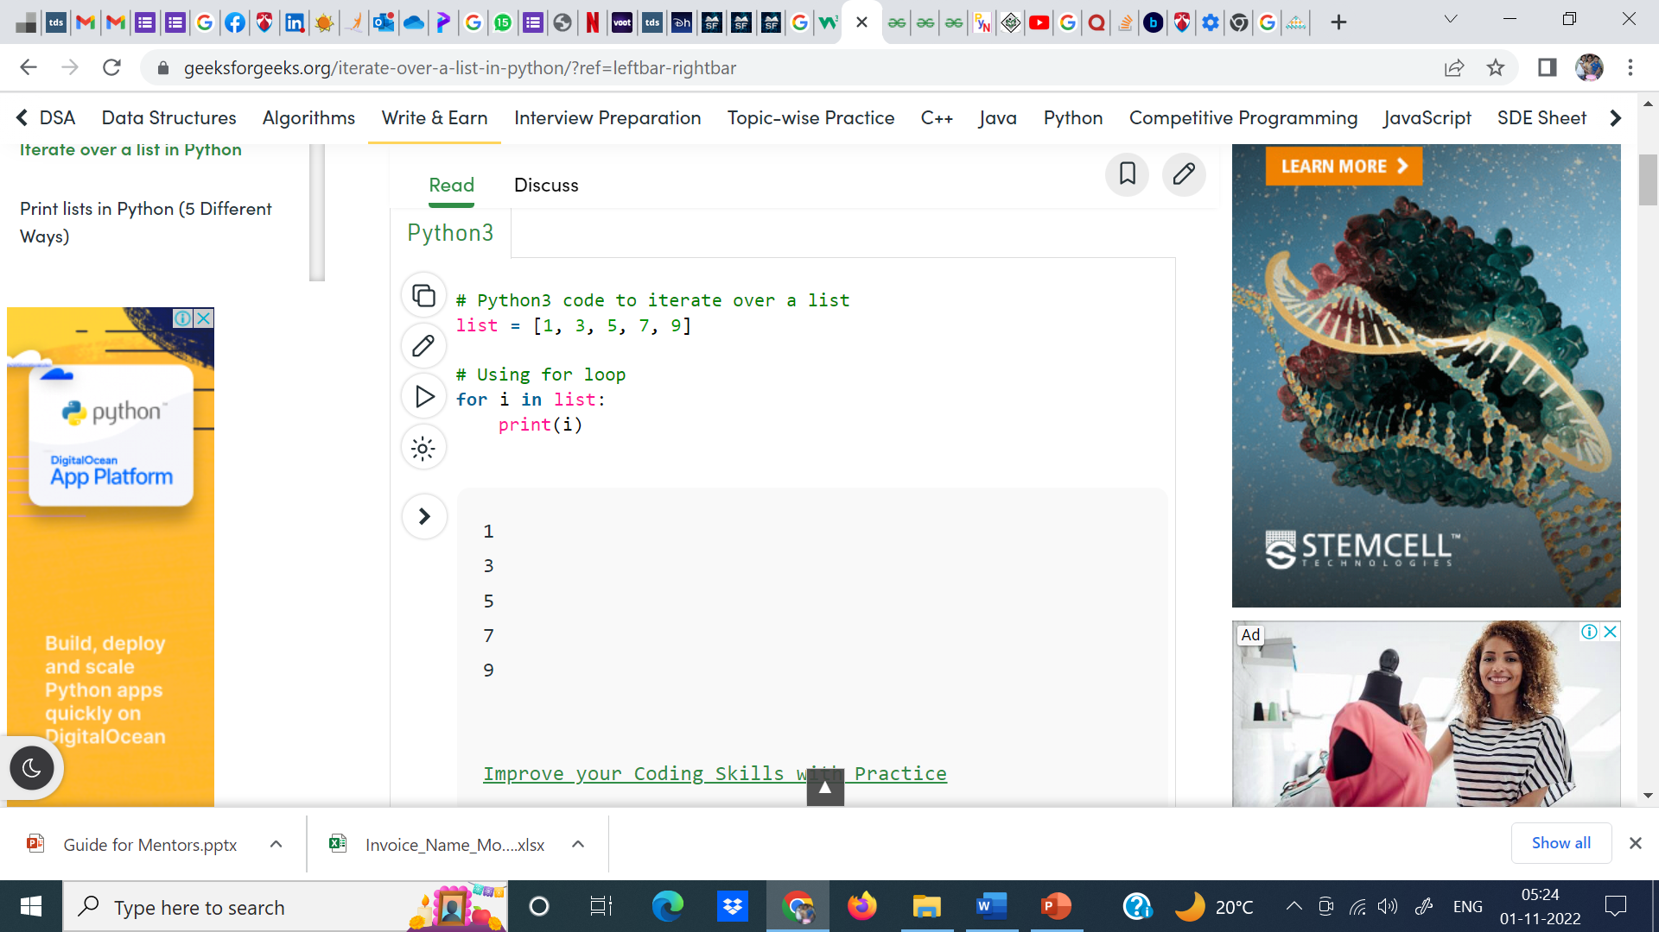

Slide 8
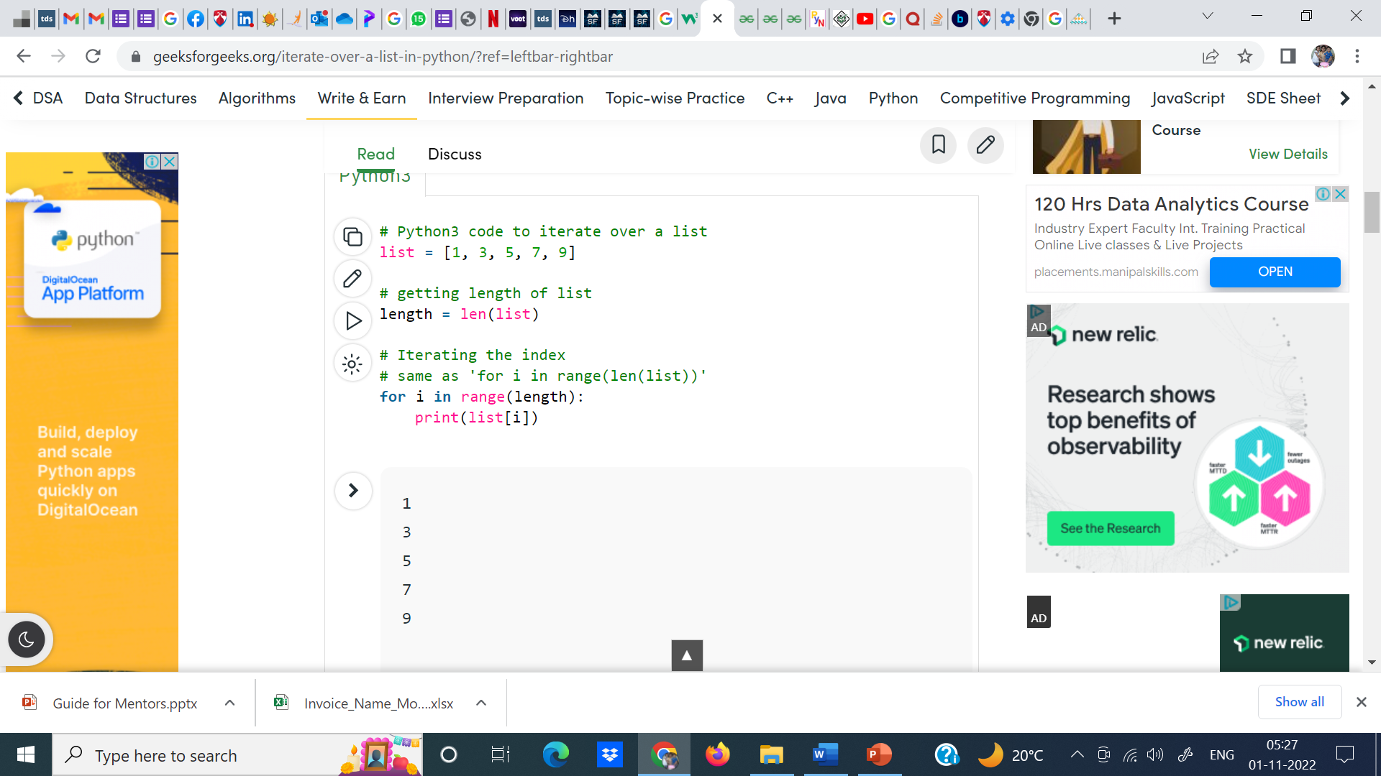
In case we want to use the traditional for loop which iterates from number x to number y.

Slide 9
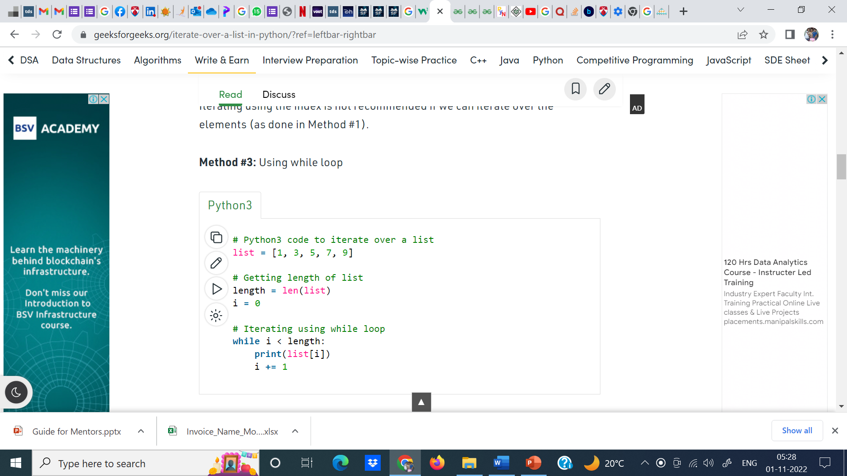

Slide 10
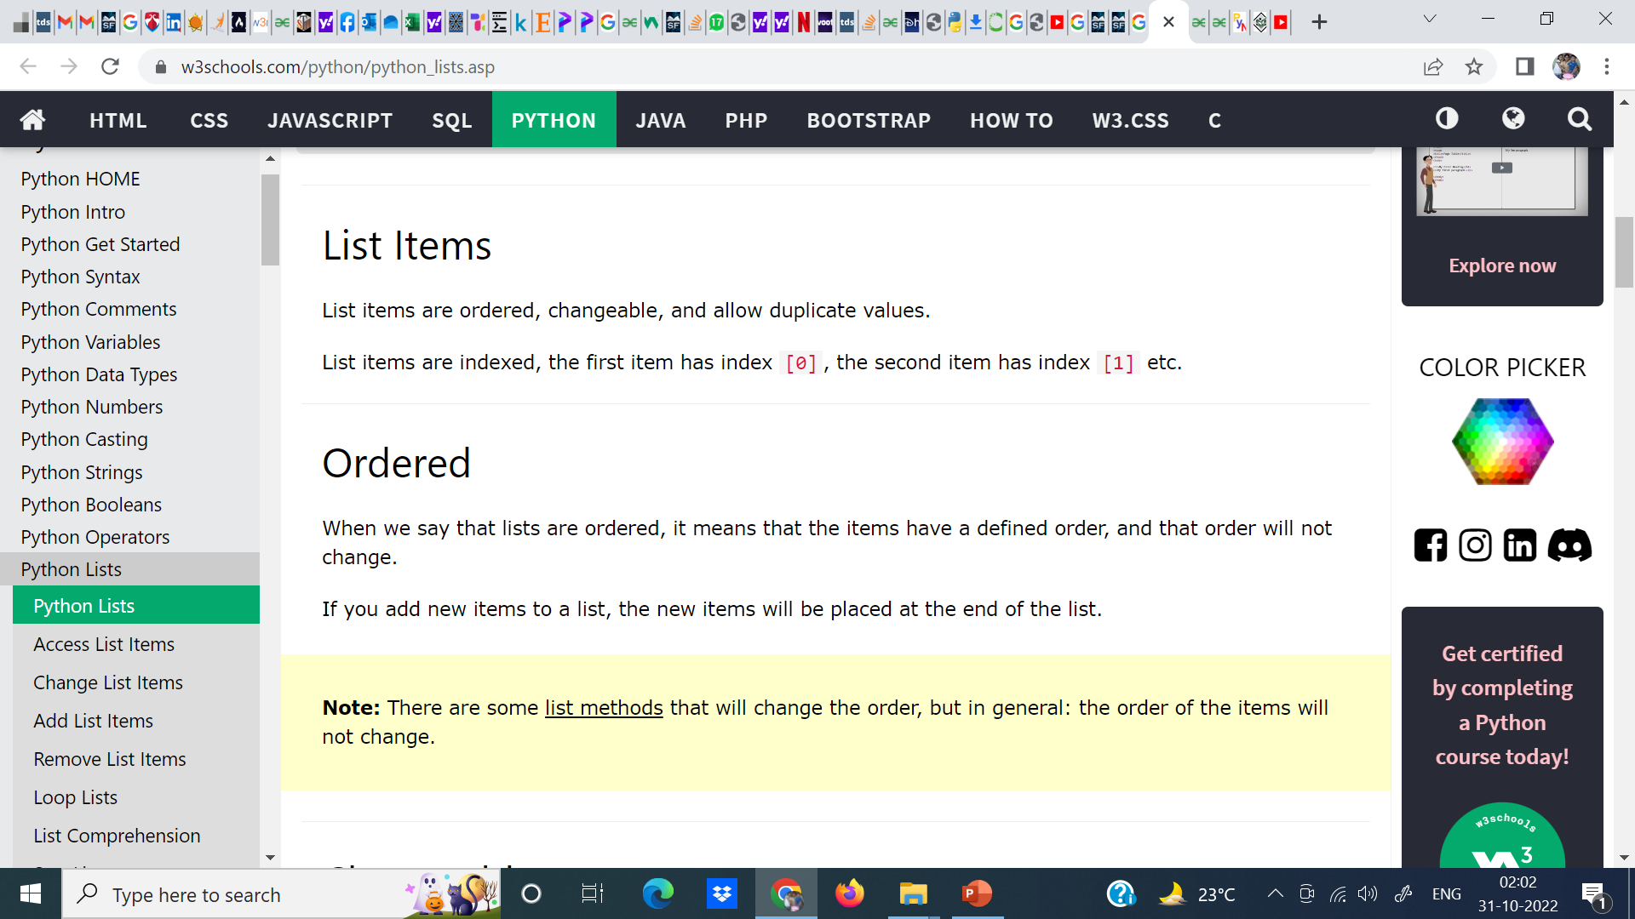

Slide 11
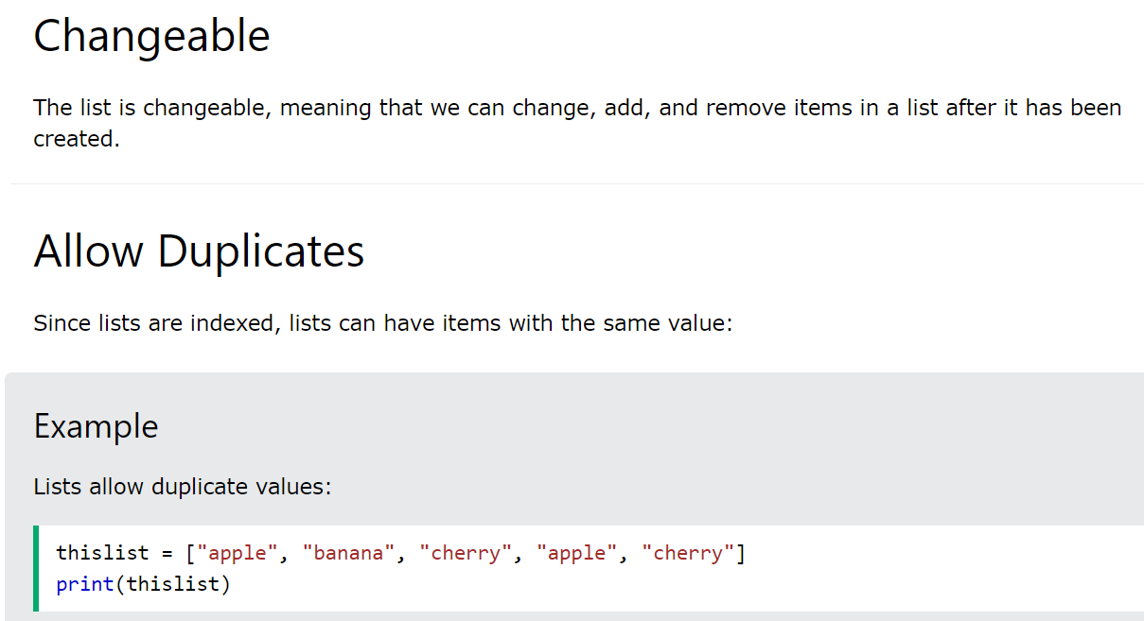

Slide 12
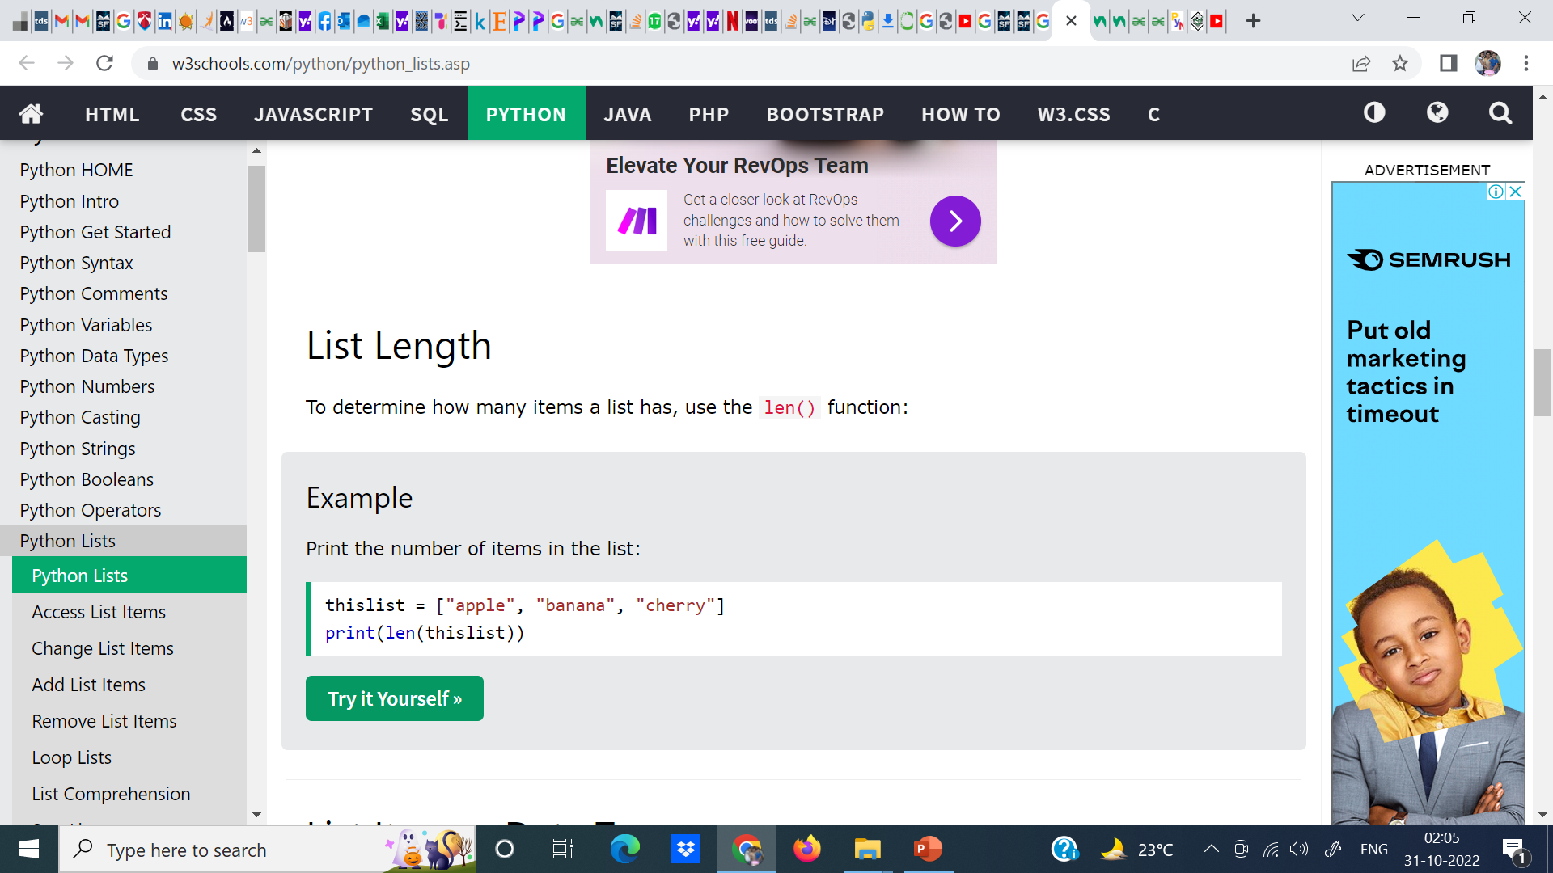
Output:
3

Slide 13
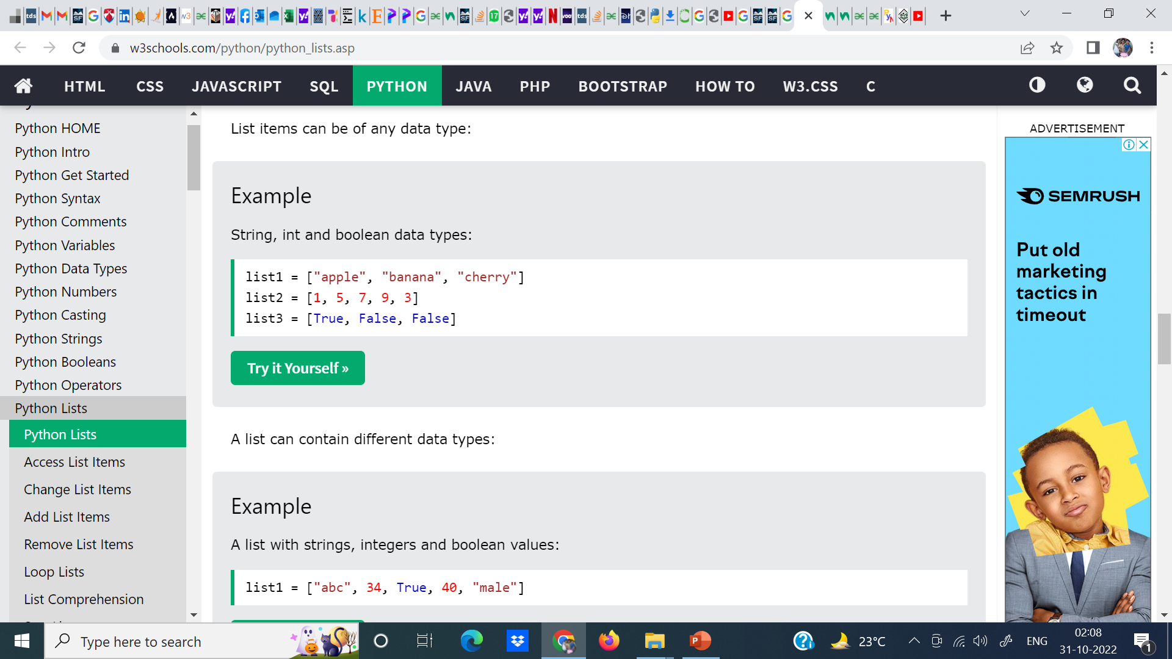
Output:
['apple', 'banana', 'cherry']
[1, 5, 7, 9, 3]
[True, False, False]
Output:
['abc', 34, True, 40, 'male']

Slide 14
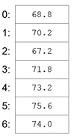
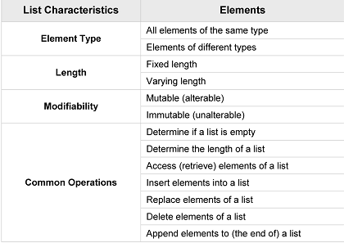
List Structures
A list is a linear data structure, meaning that its elements have a linear ordering. That is, there is a first element, a second element, and so on.

Slide 15
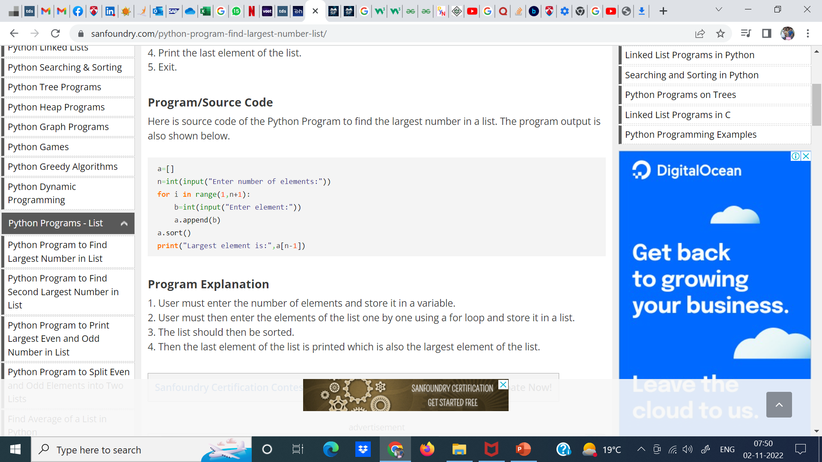

Slide 16
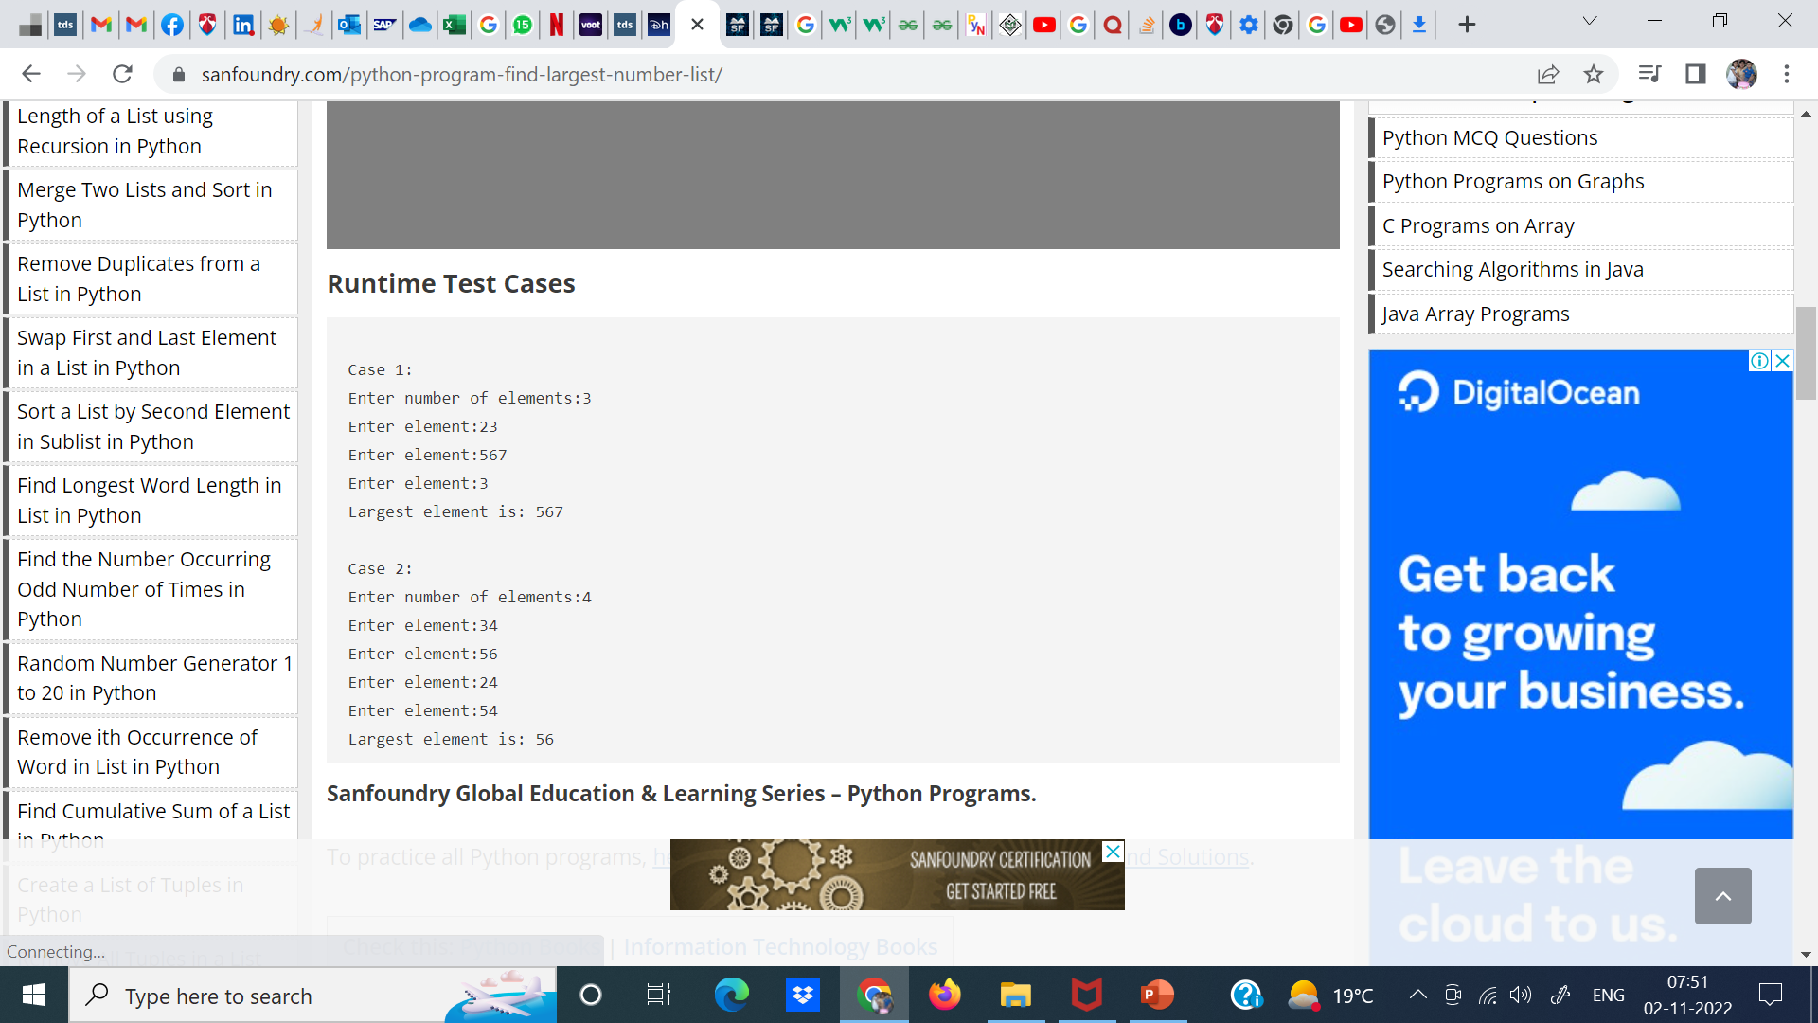

Slide 17
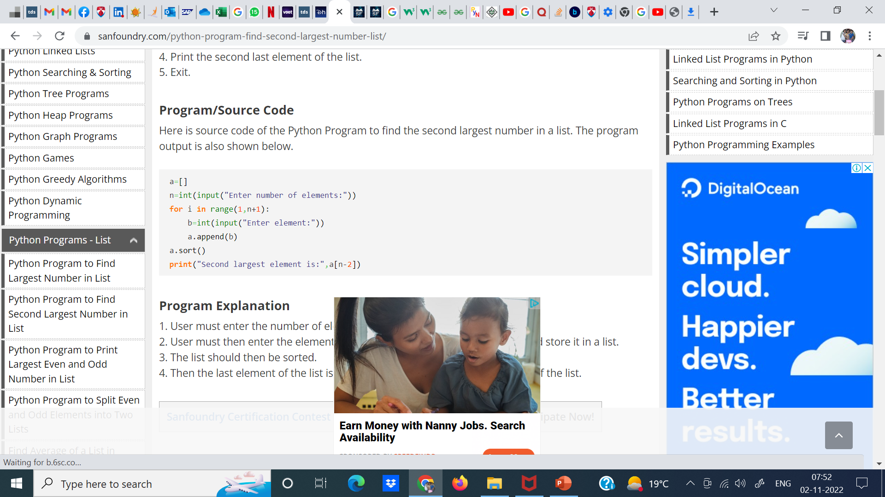

Slide 18
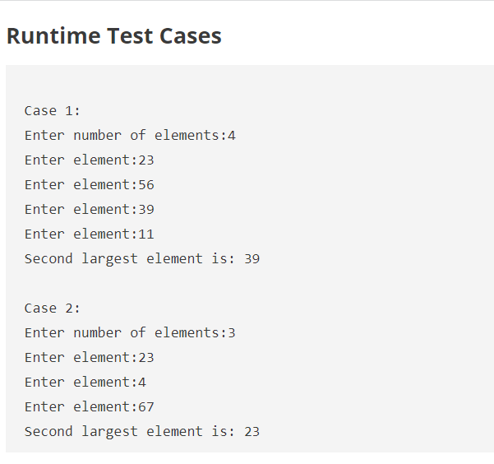

Slide 19
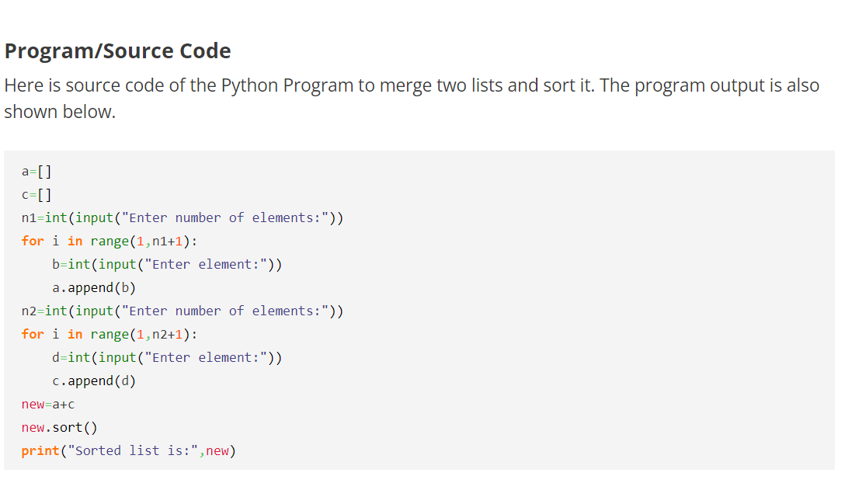

Slide 20
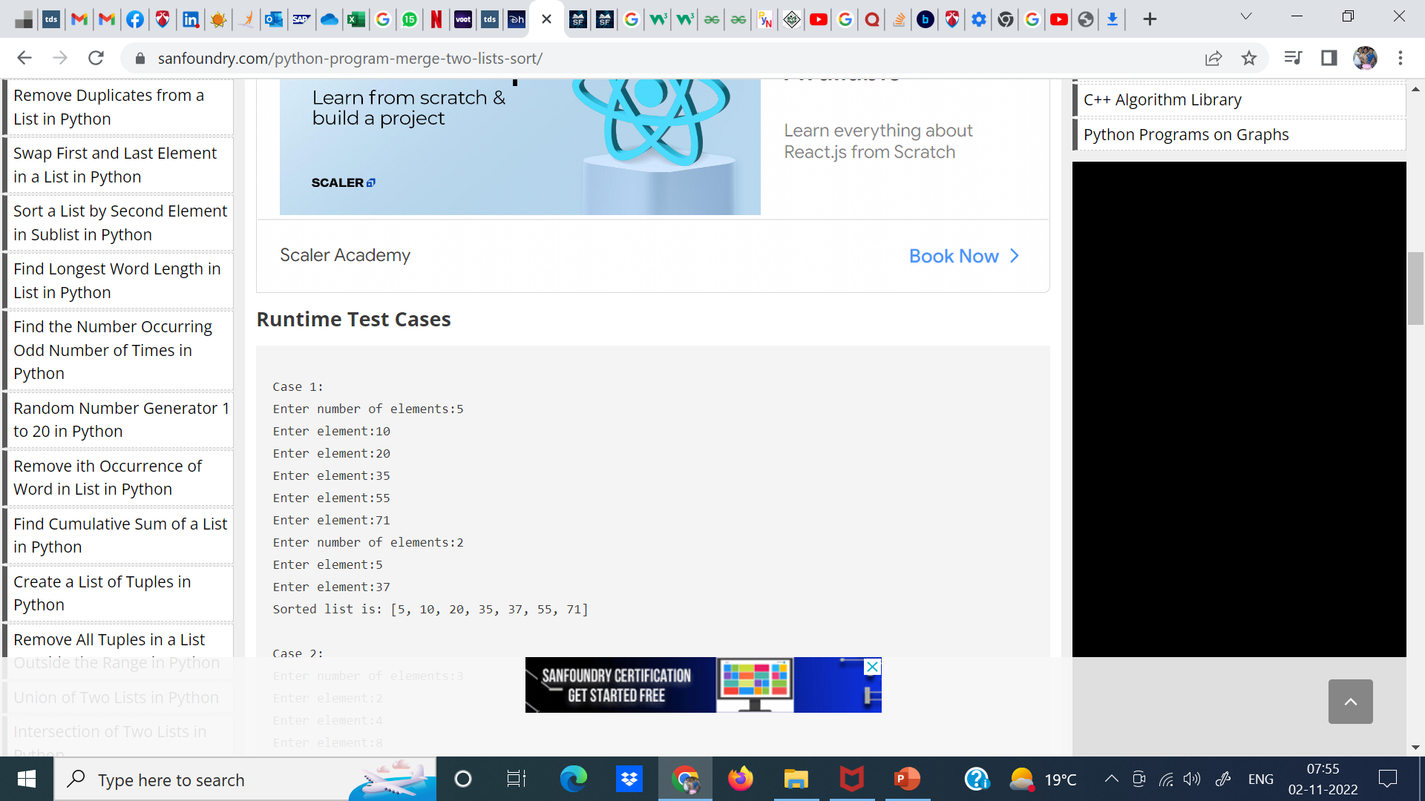

Slide 21
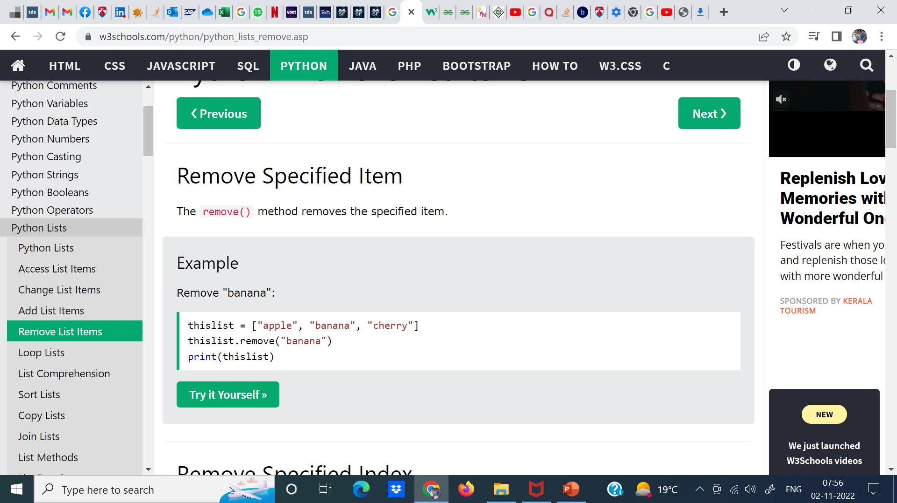
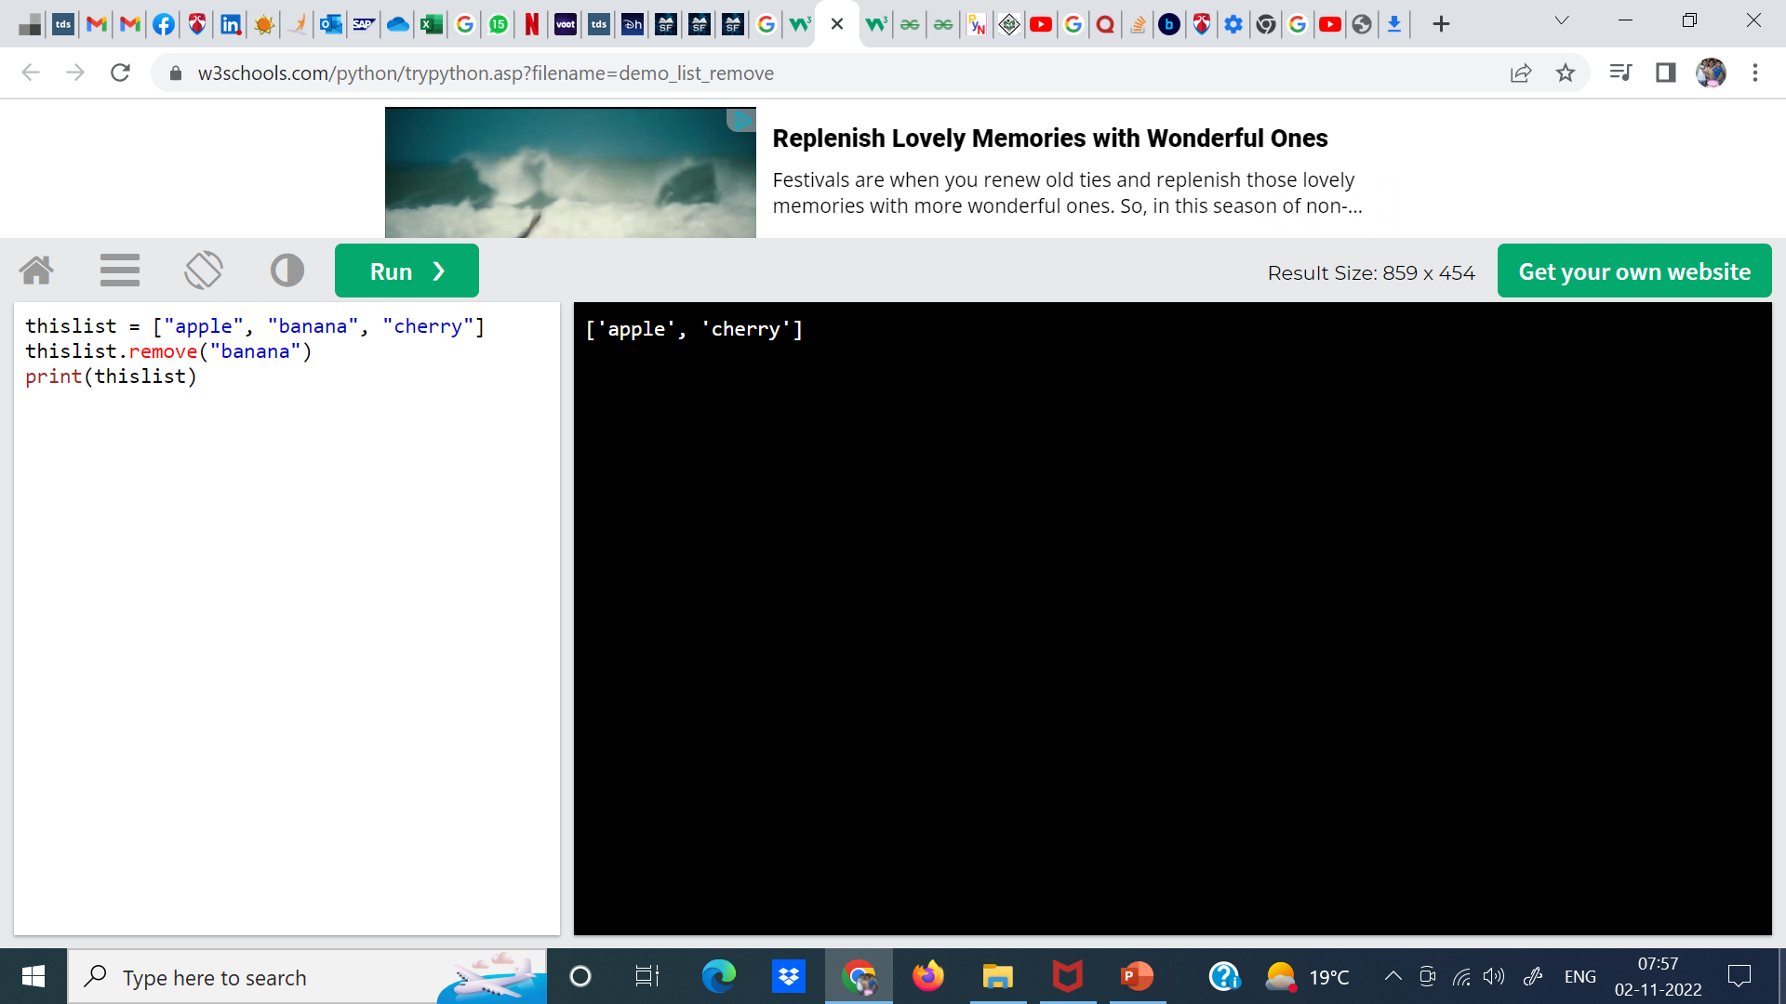

Slide 22
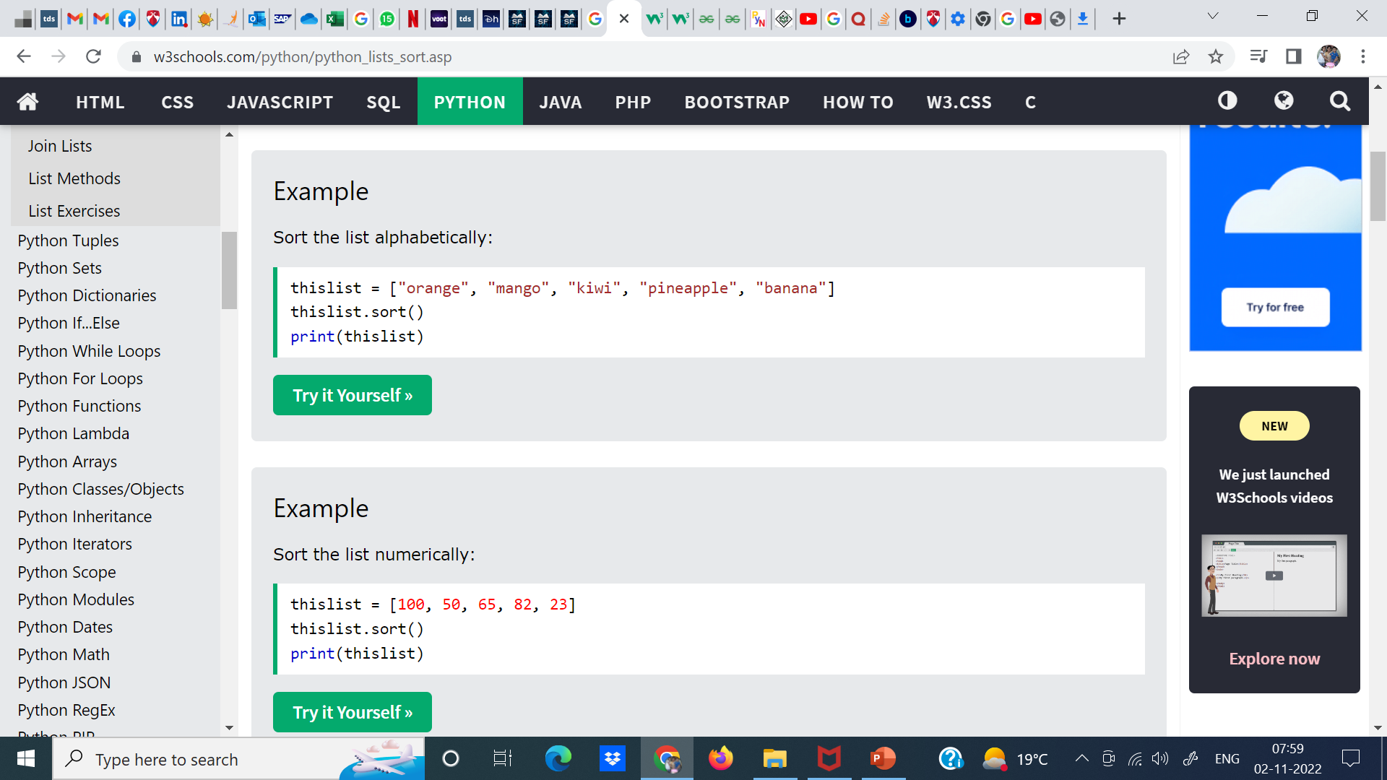

Slide 23
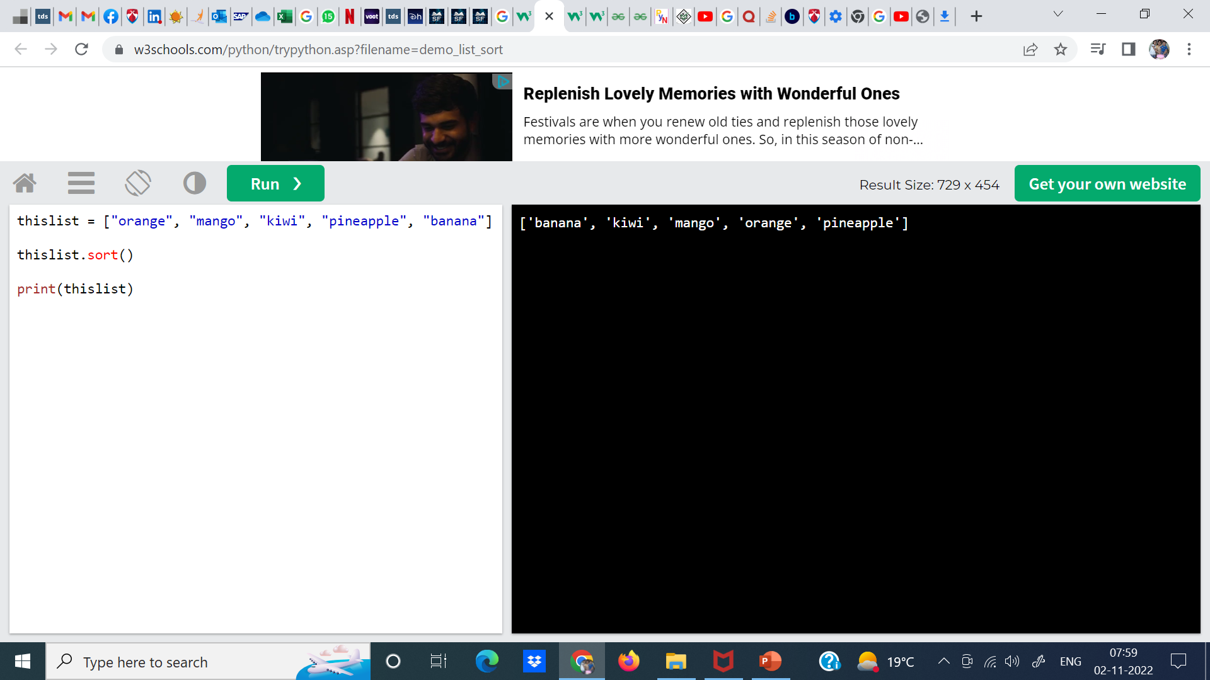
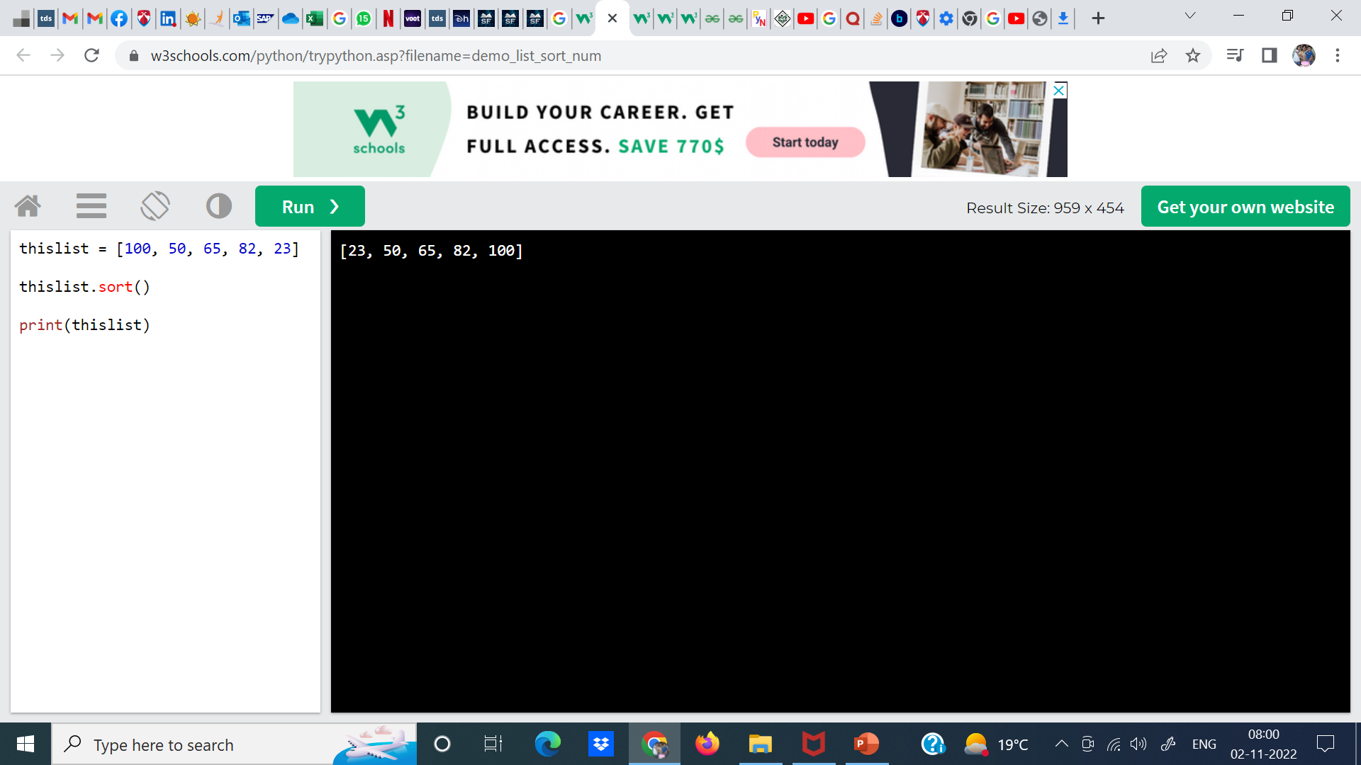

Slide 24
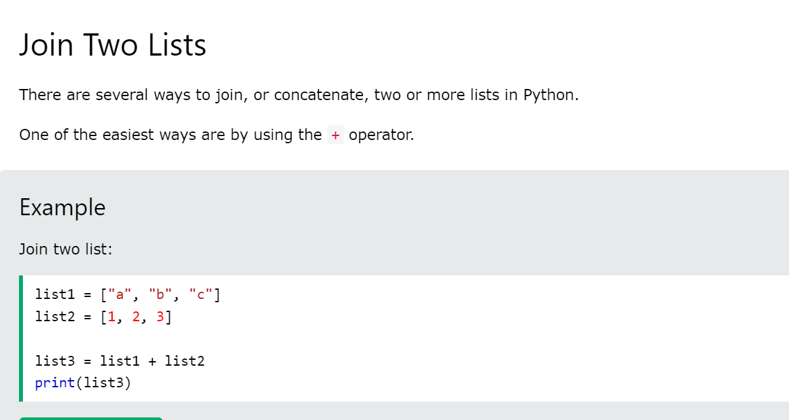

Slide 25
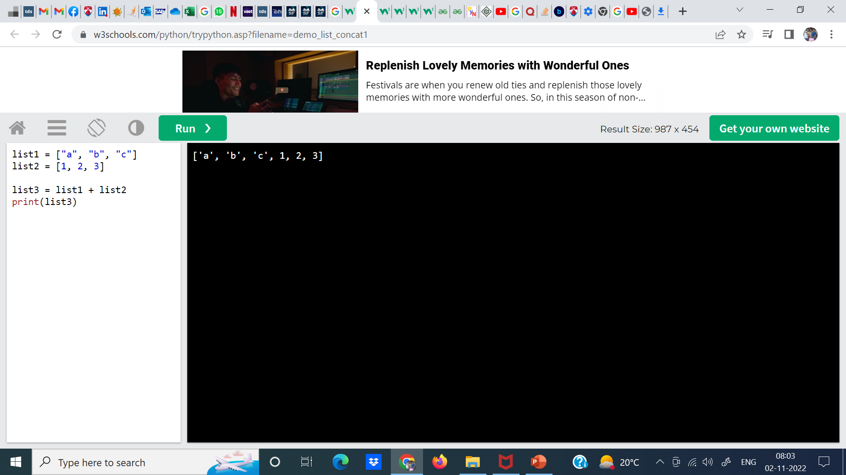

Slide 26
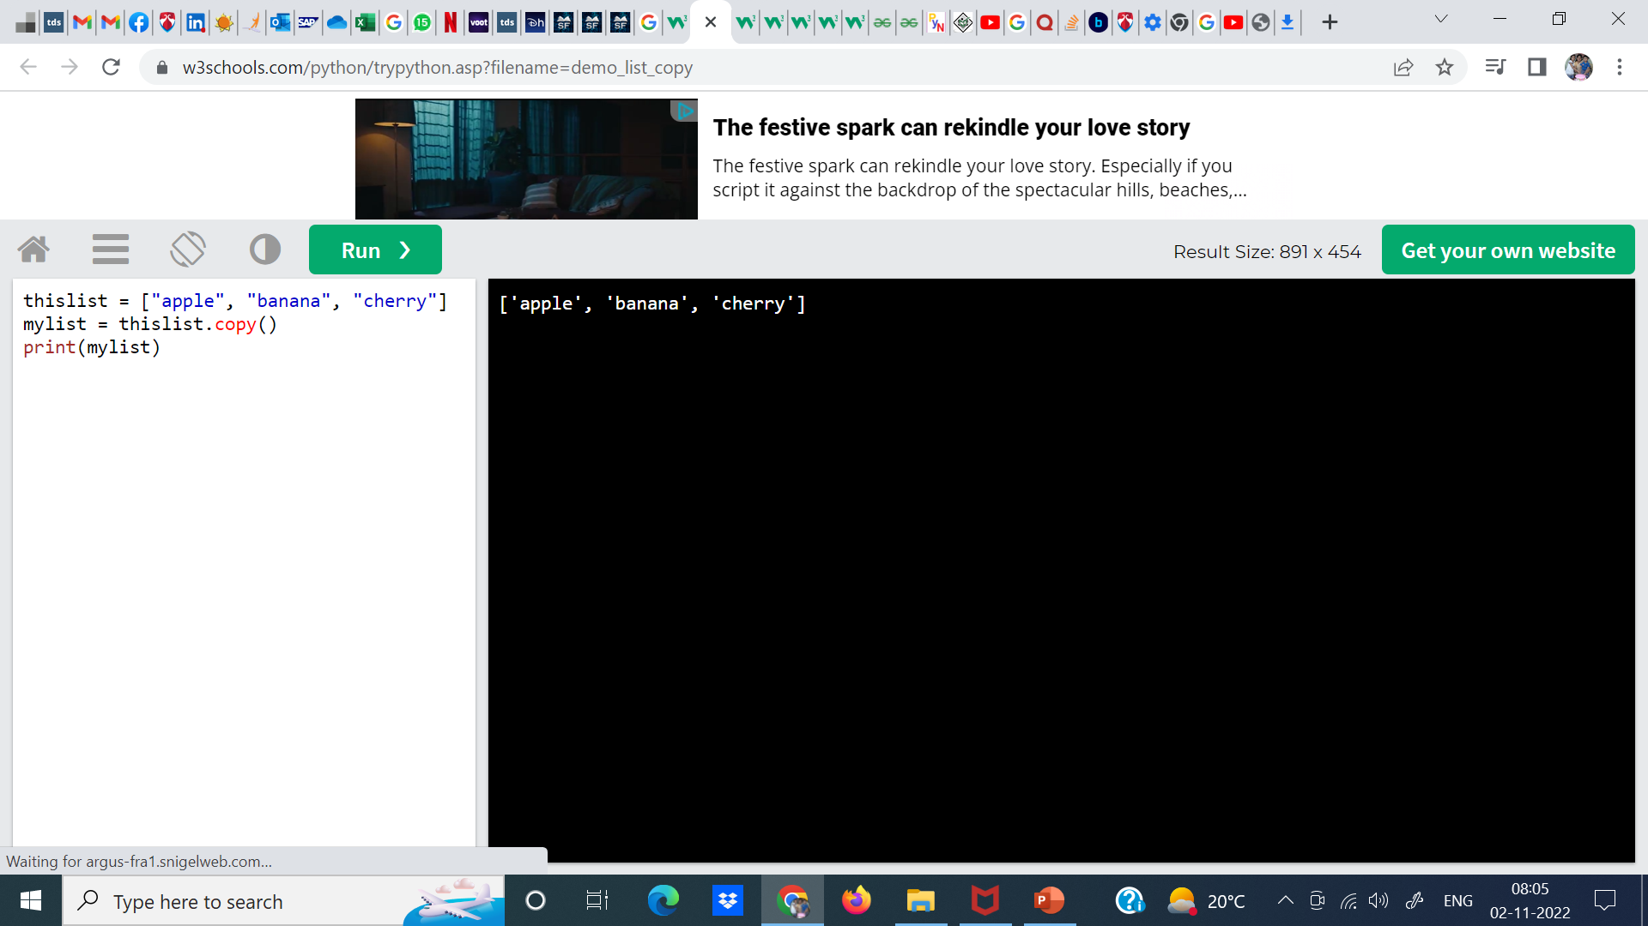

Slide 27
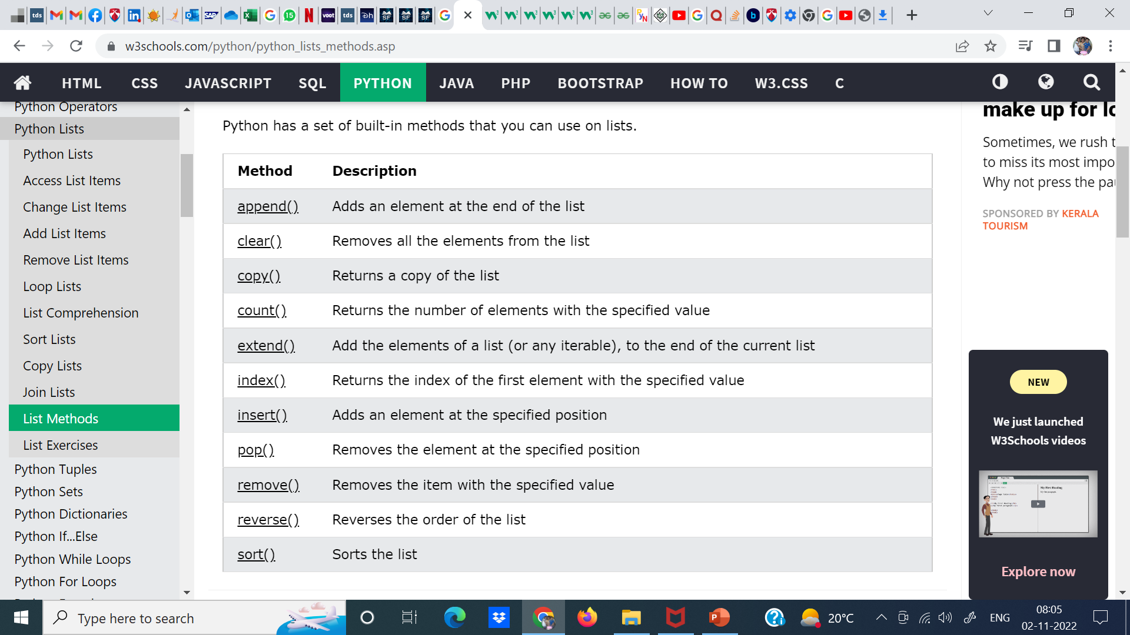

Slide 28
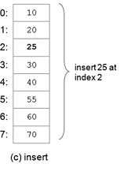
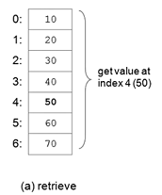
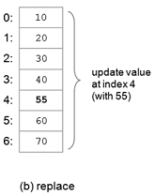
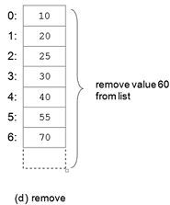
Common List Operations
Operations commonly performed on lists include retrieve, update, insert, remove, and append.

Slide 29
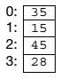
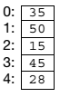
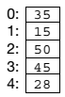
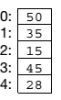
MCQs: Answers
1. What would be the range of index values for a list of 10 elements?
(a) 0–9 (b) 0–10 (c) 1–10
2. Which one of the following is NOT a common operation on lists?
(a) access (b) replace (c) interleave (d) append (e) insert (f ) delete
3. Which of the following would be the resulting list after inserting the value 50 at index 2?
(a) (b) (c)

Slide 30
MCQs: Answers
1. What would be the range of index values for a list of 10 elements?
(a) 0–9 (b) 0–10 (c) 1–10
2. Which one of the following is NOT a common operation on lists?
(a) access (b) replace (c) interleave (d) append (e) insert (f ) delete
3. Which of the following would be the resulting list after inserting the value 50 at index 2?
(a) (b) (c)

Slide 31
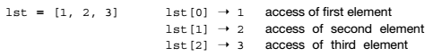
Lists (Sequences) in Python
A list in Python is a mutable linear data structure, denoted by a comma-separated list of elements within square brackets, allowing mixed-type elements. Mutable means that the contents of the list may be altered.
Elements are indexed from 0 to n-1 , where n is number of elements in the list.
Example: [1, 2, 3], ['one', 'two', 'three’], ['apples', 50, True]
An empty list is denoted by an empty pair of square brackets, [].
Negative indexing, i.e, -1 and -2 refers to the last and second last items. Ex. lst[-1]=3, lst[-2] = 2.
Range Search : lst[0:2] = [1, 2]

Slide 32
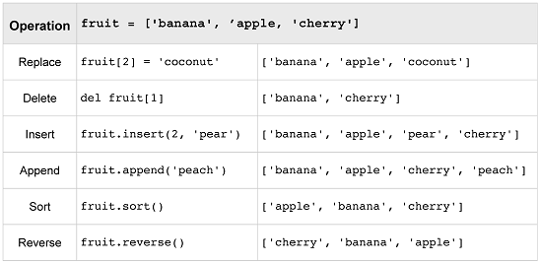
List Modification Operations in Python

Slide 33
Python Program to Find Largest Number in a List
a=[]
n=int(input("Enter number of elements:"))
for i in range(1,n+1):
b=int(input("Enter element:"))
a.append(b)
a.sort()
print("Largest element is:",a[n-1])
Case 1:
Enter number of elements:3
Enter element:23
Enter element:567
Enter element:3
Largest element is: 567

